Slide 1
KARAVALI INSTITUTE OF TECNOLOGY
DEPARTMENT OF ELECTRONICS AND COMMUNICATION ENGINEERING
MAJOR PROJECT PRESENTATION
ON
“ PicoRV-32 BASED SoC “
UNDER THE GUIDANCE OF:
Dr. Ravi M. K,
professor, ECE
KIT, Mangalore
PRESENTED BY:
Mr. Siddesh S S 4KM22EC006
Mr. Suprith M U 4KM22EC007
Ms. Vinushree A A 4KM22EC008
Ms. Suraj Chavan 4KM23EC400

Slide 2
TOPICS TO BE DISCUSSED
INTRODUCTION
RISC-V OVERVIEW
PICO-RV32 PROCESSOR
SYSTEM ARCHITECTURE
MODULE DESCRIPTION
SIMULATION AND TESTING RESULTS
ADVANTAGES
APPLICATIONS
CONCLUSION AND FUTURE SCOPE

Slide 3
INTRODUCTION
Modern electronic devices use a processor and memory for computation
Proper communication between them is essential for system operation
Before making real hardware, industry verifies designs through simulation
Our project simulates a small System on Chip (SoC) using the PicoRV32 RISC-V processor
The goal is to understand how a CPU fetches instructions and accesses memory internally

Slide 4
RISC-V OVERVIEW
RISC-V is an open-source processor instruction set
No license cost or restrictions
Allows anyone to design and modify CPUs
Supports small microcontrollers to high performance processors
Widely used in education, research, and semiconductor industry
Ideal for teaching and learning processor architecture

Slide 5
PICO-RV32 PROCESSOR
• PicoRV32 is a small and lightweight RISC-V CPU core
• Supports basic 32-bit RISC-V instructions
• Performs arithmetic, branching, load and store operations
• Uses simple handshake signals to communicate with external memory
• Easy to integrate with custom controllers and test in simulation
• Open-source design, commonly used in education and SoC projects
• Selected in our project for its simplicity and flexibility

Slide 6
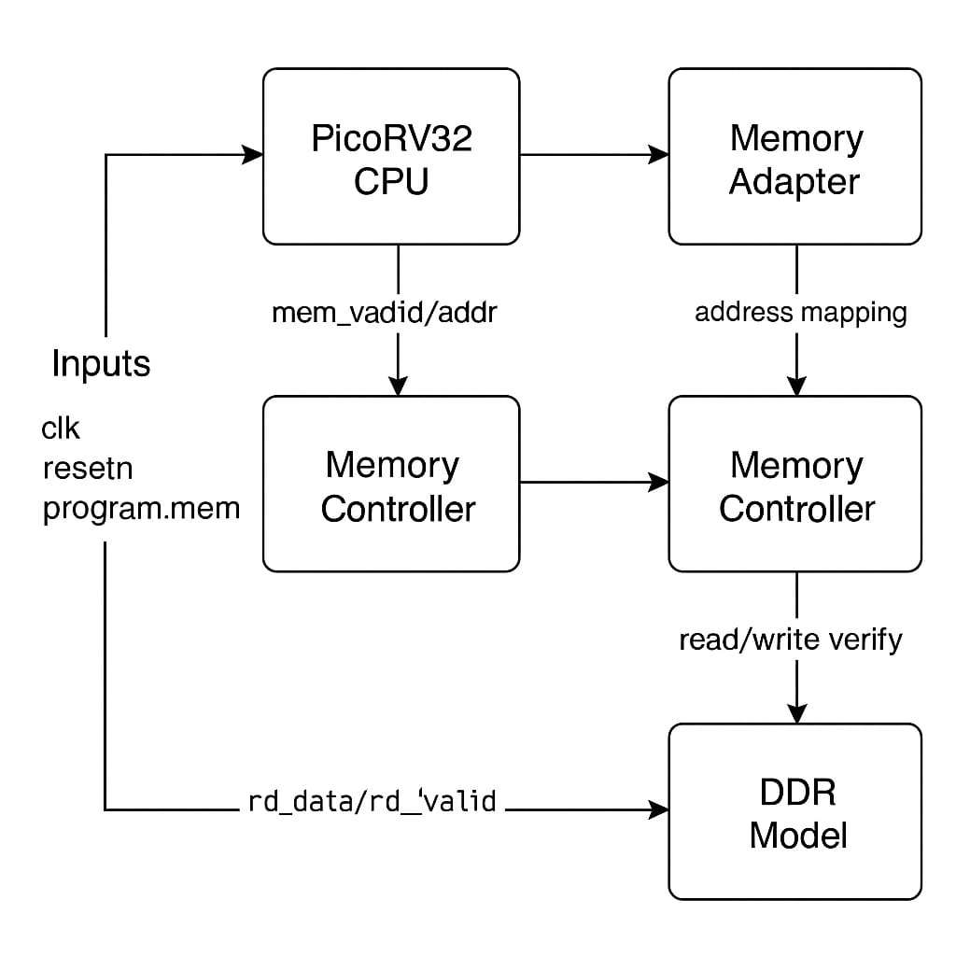
SYSTEM ARCHITECTURE

Slide 7
SYSTEM ARCHITECTURE EXPLANATION
• CPU sends read/write requests and addresses
• Adapter converts CPU format to DDR compatible format
• Controller manages timing and performs memory operations
• DDR Model stores instructions/data during simulation
• Testbench provides clock, reset, and program memory
• Verified complete instruction fetch and data transfer in simulation

Slide 8
MODULE DESCRIPTION
PROGRAM.MEM INPUT
TEXT FILE CREATION AND INTEGRATION
echo 222222b7>>program.mem
echo 22228293>>program.mem
echo 00502823>>program.mem
echo 01002283>>program.mem
echo 0000006f>>program.mem
echo 00000013>>program.mem
echo 00000013>>program.mem
echo 00000013>>program.mem

Slide 9
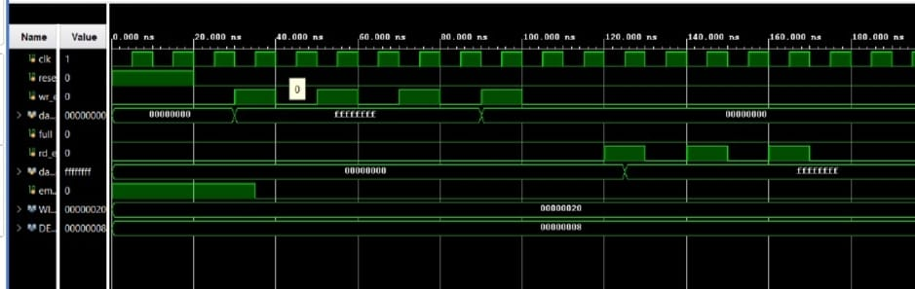
SIMULATION BASED TESTBENCH OUTPUT
FIFO OUTPUT
• Testbench writes data into FIFO using write enable
• FIFO stores data sequentially (First-In First-Out behavior)
• Read enable retrieves data in the same order as written
• Waveform verifies correct FIFO operation under simulation

Slide 10
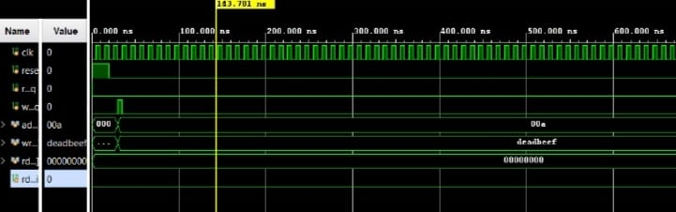
DDR MODEL OUTPUT
• Testbench sends a read request to the DDR model • DDR model accesses stored instruction/data
• After a small latency, DDR returns data on rd_data signal
• rd_valid indicates that the returned data is valid
• Waveform confirms correct memory read operation in simulation

Slide 11
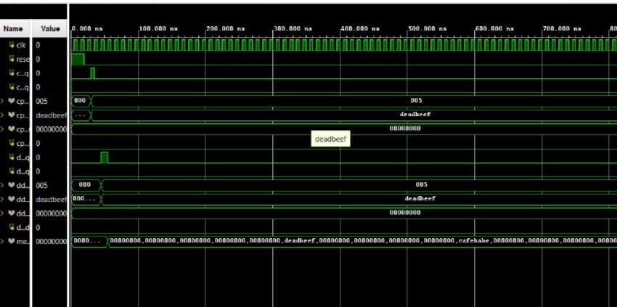
MEM_CONTROLLER WAVWFORM
• Receives read/write requests from CPU through signals
• Generates control signals for DDR memory access
• Handles timing delays and protocol sequencing
• Returns read data to CPU after operation completes
• Ensures reliable communication between CPU and memory

Slide 12
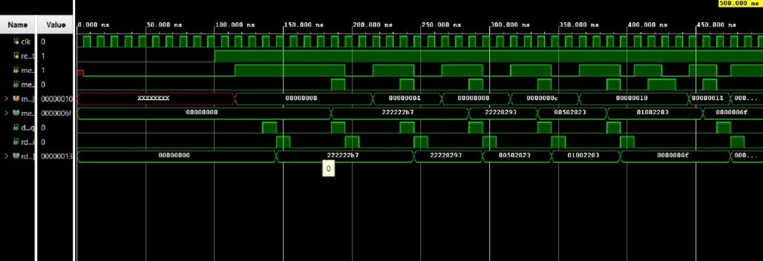
TOP_PICORV32_SYSTEM WAVEFORM
• CPU fetches instructions from DDR memory via controller and adapter
• Handshake signals (mem_valid, mem_ready) control data transfer
• Instruction and data values appear correctly on read data lines
• Timing sequence confirms proper read and execution flow
• Demonstrates complete end to end communication in simulation

Slide 13
ADVANTAGES & APPLICATION
ADVANTAGES
Open Source and License Free: Built on the open RISC-V architecture using freely available tools, eliminating licensing and proprietary constraints.
Modular and Scalable Architecture: CPU, memory adapter, controller, and DDR modules are independent, allowing easy modification or upgrades without affecting the entire system.
Easy Simulation and Debugging: Complete signal visibility through waveform analysis in tools like Vivado makes debugging and learning very effective.
Low Resource and Cost Efficient: Requires minimal hardware and computational resources, making it ideal for students and academic institutions.
End-to-End SoC Learning Platform: Provides practical understanding of the full SoC flow, from instruction execution to memory access, similar to industrial designs.

Slide 14
APPLICATION
Embedded SoC Development: Can be used as a base platform for designing custom embedded processors for control and monitoring systems.
FPGA Based Microcontroller Design: Easily portable to FPGA boards to create low-cost and customizable microcontroller solutions.
RISC-V Education and Research: Highly suitable for teaching processor architecture, memory interfacing, and SoC concepts in universities.
IoT Edge Processing Systems: With minor extensions, the design can support lightweight computation for IoT edge devices.
Verification and Prototyping Platform: Acts as a reusable testbench for experimenting with new instruction sets, memory models, or architectural enhancements.

Slide 15
CONCLUTION
The PicoRV32-based SoC was successfully designed and simulated using SystemVerilog on the Vivado environment.
End-to-End communication between CPU, memory adapter, memory controller, and DDR model was verified through waveform analysis.
The instruction fetch and memory read/write operations were validated using handshake signals, proving correct functional behavior.
The modular architecture allowed individual testing of each block (FIFO, controller, DDR model) before integration.
The project demonstrates a realistic pre-silicon verification approach, similar to how SoCs are tested in industry before hardware fabrication.

Slide 16
FUTURESCOPE
Hardware Implementation: The design can be implemented on FPGA boards (e.g., Artix-7, Cyclone V) for real-time execution and performance evaluation.
Peripheral Expansion: Additional modules like UART, SPI, I2C, GPIO, and timers can be integrated for embedded system applications.
Real DDR Controller Integration: Behavioral DDR model can be replaced with a cycle-accurate DDR controller with burst, refresh, and timing support.
Software & OS Support: Support for C programs and lightweight operating systems (like FreeRTOS) can enable practical application development.
IoT & Edge Use-Cases: With small power footprint and open-source CPU, the platform can be adapted for IoT nodes, microcontrollers, and edge processing systems.

Slide 17
THANK YOU

